Slide 1




Requirements & Project Management
Microsoft TFS
Azure Boards
Atlassian Confluence
Atlassian Jira Software

Slide 2
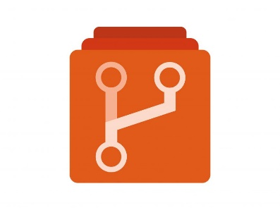



Source Code Management
Azure Repo Git/TFVC
Github Enterprise
Bitbucket
Gitlab Ultimate

Slide 3



Code Analysis and Code Coverage
SonarQube
SonarCloud
Jacoco

Slide 4

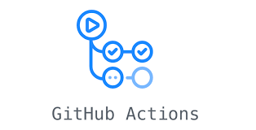






Continuous Integration & Continuous Delivery
Azure Pipelines
Jenkins
GitHub Action Workflow
Gitlab Pipelines
Flyway
Bamboo
CicrleCI
BitBucket Pipelines

Slide 5
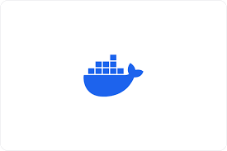




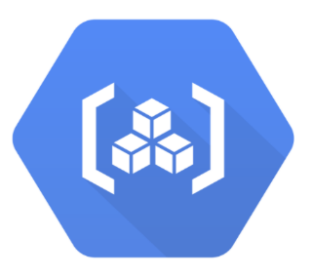


Containerization
Docker
Kubernetes
AWS ECR
AWS ECS
AWS EKS
Helm Charts
GKE
Azure Kubernetes Services - AKS

Slide 6



Test Management
Azure Test Plans
XRAY
Testrail

